Slide 1



Ad Hoc Insights
ATLIQ HARDWARES
Domain : Consumer Goods
Presented by : Nuthin B

Slide 2

AGENDA
INTRODUCTION TO COMPANY
-------------------------------------------
ATLIQ BUSINESS MODEL
-------------------------------------------
INPUTS PROVIDED
-------------------------------------------
REQUESTED AD-HOC INSIGHTS
-------------------------------------------

Slide 3






ATLIQ HARDWARES
Company Overview
Problem
Ultimate goal
Atliq hardware is a company that specializes in manufacture and distribution of computer hardware across four key regions
The management at Atliq has observed a lack of sufficient insights to enable quick and smart data-driven decisions.
They plan to expand their data analytics team with junior analysts. To assess both technical and soft skills, Tony Sharma, the data analytics director, decided to conduct a SQL challenge.
DIVISIONS :
Networking &
Storage
Peripherals & Accessories
Personal
Computers

Slide 4
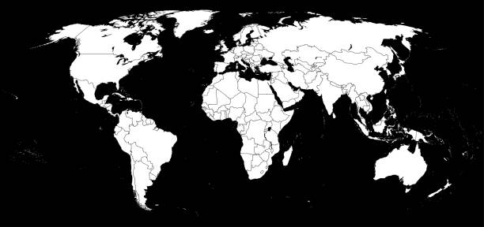
EU
LATAM
APAC
NA
REGIONS
Fiscal Year 2020
Sep 2019 – Aug 2020
Fiscal Year 2021
Sep 2020 – Aug 2021

Slide 5
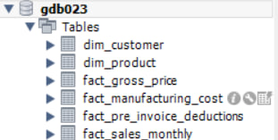
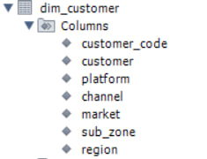


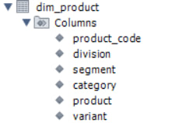
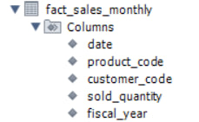
INPUTS PROVIDED

Slide 6
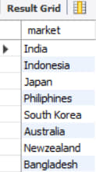
REQUESTED AD-HOC INSIGHTS
Request – 1 :
Provide the list of markets in which customer "Atliq Exclusive" operates its business in the APAC region.
Output

Slide 7

Insight :
In APAC region, our exclusive store has established it’s presence in 8 major markets.
South
Korea
Japan
India
Bangladesh
Philippines
Indonesia
Australia
New Zealand

Slide 8

Request – 2 :
What is the percentage of unique product increase in 2021 vs. 2020? The final output contains these fields :
unique_products_2020 unique_products_2021
percentage_chg
Output
Insight
36.33%

Slide 9
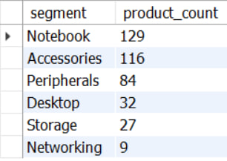
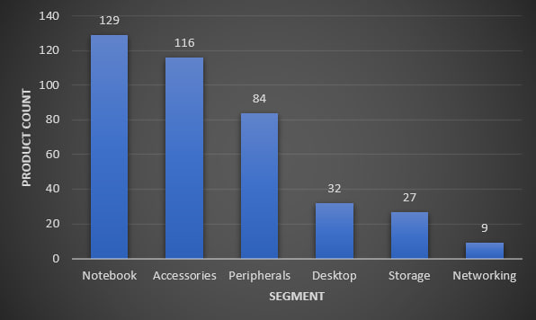
Request – 3 :
Provide a report with all the unique product counts for each segment and sort them in descending order of product counts. The final output contains 2 fields
segment
product_count
Output
Insight

Slide 10
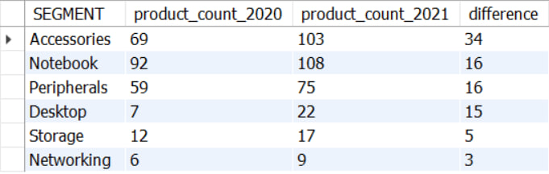
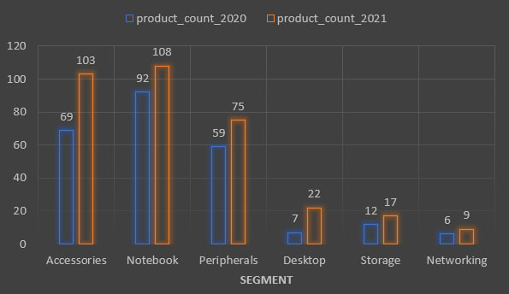
Request – 4 :
Follow-up: Which segment had the most increase in unique products in 2021 vs 2020? The final output contains these fields
segment
product_count_2020 product_count_2021 difference
Output
Low production growth comparatively with other segments
Insight

Slide 11

Request – 5 :
Get the products that have the highest and lowest manufacturing costs. The final output should contain these fields
product_code
Product
manufacturing_cost
Output

Slide 12
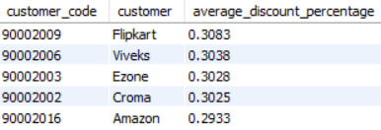
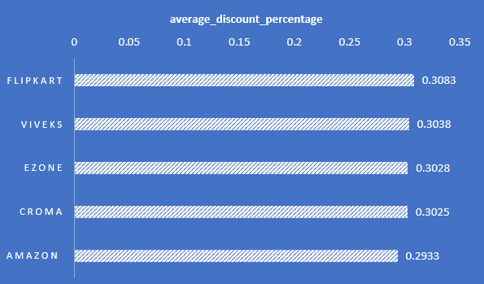
Request – 6 :
Generate a report which contains the top 5 customers who received an average high pre_invoice_discount_pct for the fiscal year 2021 and in the Indian market. The final output contains these fields
customer_code
customer average_discount_percentage
Output
Insight

Slide 13
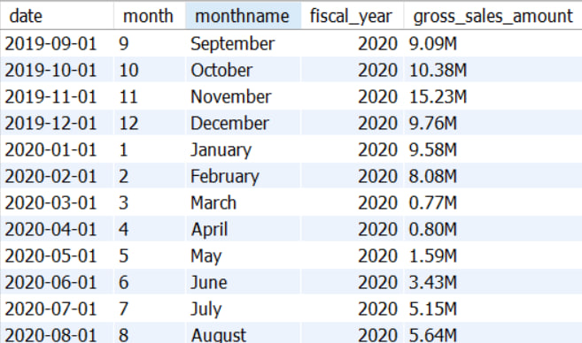
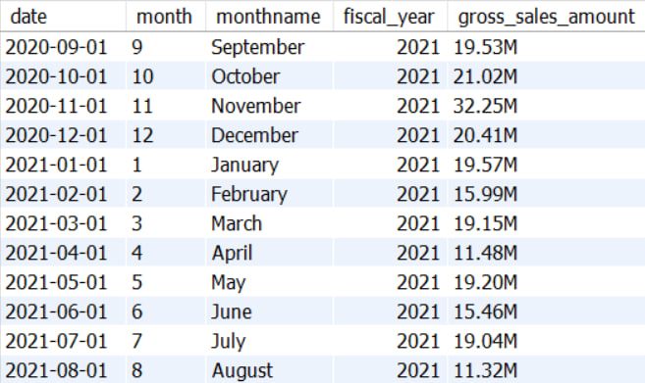
Request – 7 :
Get the complete report of the Gross sales amount for the customer “Atliq Exclusive” for each month. This analysis helps to get an idea of low and high-performing months and take strategic decisions. The final report contains these columns:
Month
Year
Gross sales Amount
Output

Slide 14
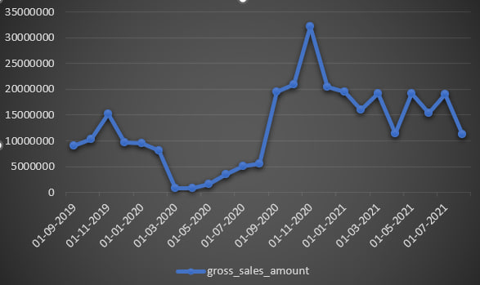

Insight
March 2020
April 2020
May 2020
June 2020
July 2020
August 2020

Slide 15
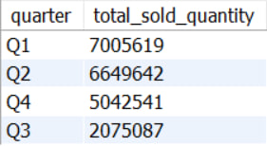
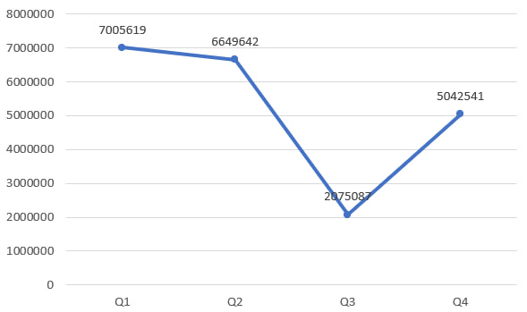
Request – 8 :
In which quarter of 2020, got the maximum total_sold_quantity? The final output contains these fields sorted by the total_sold_quantity,
Quarter
total_sold_quantity
Output
Insight

Slide 16
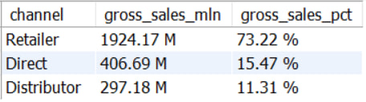
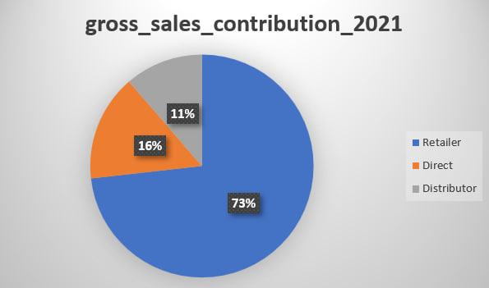
Request – 9 :
Which channel helped to bring more gross sales in the fiscal year 2021 and the percentage of contribution? The final output contains these fields
channel
gross_sales_mln
percentage
Output
Insight

Slide 17
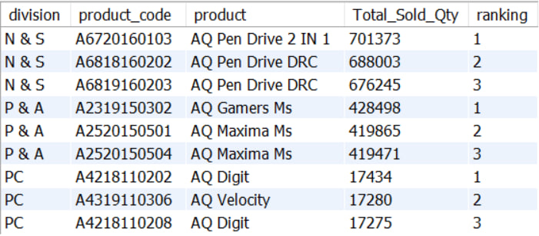
Request – 10 :
Get the Top 3 products in each division that have a high total_sold_quantity in the fiscal_year 2021? The final output contains these fields :
division
product_code
Product
total_sold_quantity
rank_order
Output

Slide 18
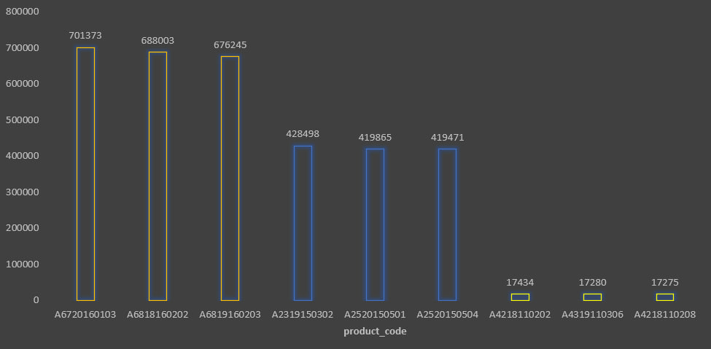
{
Insight
N & S
{
P & A
{
PC

Slide 19
Thank you 😊

